Slide 1








Intent-based Networking
Ning Wang (University of Surrey)
Charalampos Rotsos (Lancaster University)
Notes:
Notes:

Slide 2
Agenda
Overview on basic concept of Intent-based Networking (IBN)
Intent capturing and management
Intent monitoring and validation
IBN in multi-stakeholder environments

Slide 3

A Brief Review on Network Configuration Management
Traditional Configuration Management
Policy-based Network Management (PBNM)
Intent-based Network Management
Network
administrator
Network
administrator
Network
administrator
“IF <condition>
THEN <Do this>”
IF <condition>
THEN
“I Want This”
“Do This”
Network
Network
Network
Example:
Forward traffic destined to 100.100.1/24 to Port A
Example:
IF <Utilization of the bottleneck link along the primary LSP exceeds 80%>
THEN <Establish a secondary LSP>
Example:
Load balancing with maximum allowable link utilisation = 80%

Slide 4
Syntax Elements in Intent Expressions
Elements | Explanation | Examples
Action | What needs to be done? | Protect Cache Load balancing Guarantee Minimize/Maximize <service level performance - SLP>
Object | Which entity? | Network interface of 100.1.2.3 <deterministic> Shared Risk Link Group A <deterministic> Most congested network link <non-deterministic> Video traffic
Target value | Numerical requirements? | <0.01% (packet loss) <80% (e.g. worst-case link utilisation) <10 ms (e.g. E2E delay of voice traffic)
Condition | Under what situation / When? | At any time During 9AM – 7PM on working days When there is a single link failure When the network is congested

Slide 5
Who Can Express Intent (Intent client)?
Intent Client | Typical Requirement | Examples
Network operators | To maximise automation in network control / configuration with minimum human (administrator) involvement Simply network configuration complexity | Protect my network against single link/node failures Load balancing without incurring hotspot links with higher than 80% utilisation Save energy during off-peak time
Vertical service providers | To ask for service guarantees to own service subscribers | Video content provider: Guaranteed data rate of 10Mbps in video streaming for all my subscribers Autonomous vehicles: <5ms delay and zero packet loss
Enterprise networks | To ask for connectivity guarantees to own sites located in the public Internet | Guaranteed bandwidth and delay between sites
End users | Individual own circumstances (mobility etc.) | Service continuity in mobility (travelling, house moving…)

Slide 6
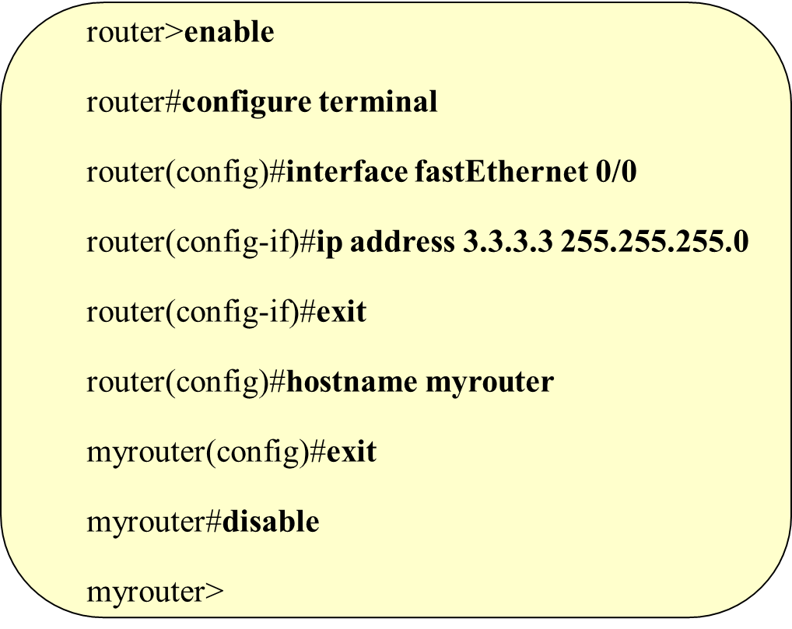
How to Express Intent?
Revisit network configuration management evolution
Document-base management tools (e.g. NetConf)
  Easy to edit
  Configure things “offline” before feeding the system
  Inherit configuration languages
Command line interface (CLI) – A Configuration “Language”
  Human understandable as configuration commands
  Simple to be “translated” to machine languages
  Flexible to add new primitives
  Prone to human errors
GUI/Web-based network management tools
  Menu selection, box ticking, input values
  Better visualisation
  No explicit Languages being used by the configuration issuer

Slide 7
How to Express Intent?
Changing from command to intent – what are the implications?
Is it possible/desirable to use one common intent interface to all types of intent clients?
“Internal” intent
  Intent expressed by the stakeholder who owns the infrastructure to be configured, e.g. telecom operator – BT
  With knowledge about the network capabilities
    Network topology
    Deployed network protocols (IP, MPLS, SDN, NFV…)
    Network slicing
  Use of intent to:
    Mitigate risks (failures etc.)
    Optimize own resource utilisation
    Service assurance
“External” intent
  Intent expressed by various external clients who do not own the infrastructure
  No knowledge about the network capabilities
  Use of intent to:
    Receive assured service performances provided from the underlying network
  Intent diversity from heterogeneous clients
  A more intelligent way than Service Level Agreement (SLA)?

Slide 8
Intent lifecycle – intent capture
Allow non-technical clients to express intents.
  e.g., avoid network upgrades during major events.
Extracts intents from natural language.
Automate intent fulfillment.

Slide 9








Intent implementation
Validate
Translate
NILE:
Intent
Definition
Language
Input
Extract
Build
Output
Feedback
Deploy

Slide 10
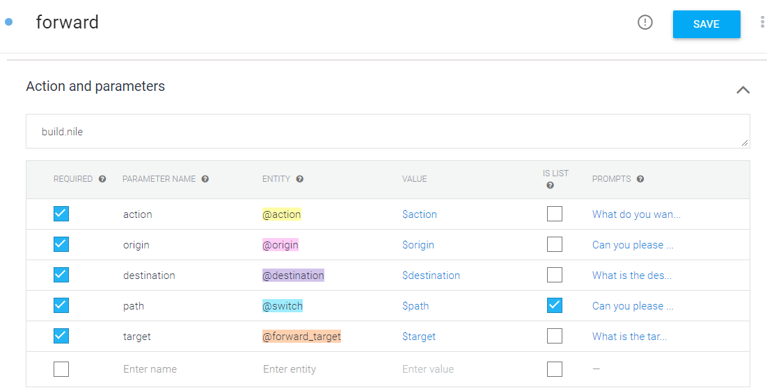
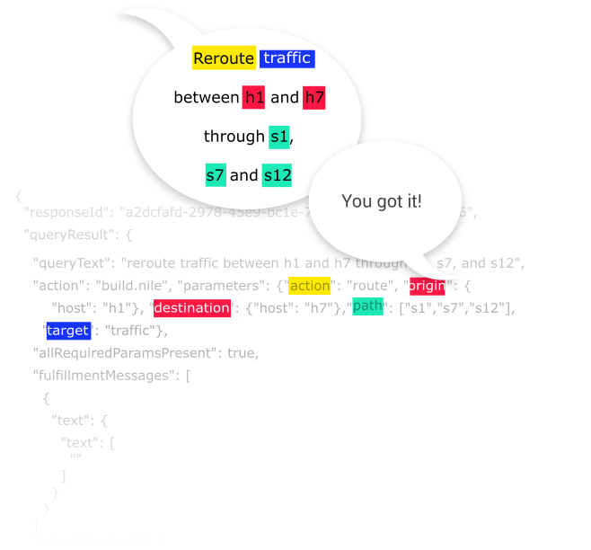
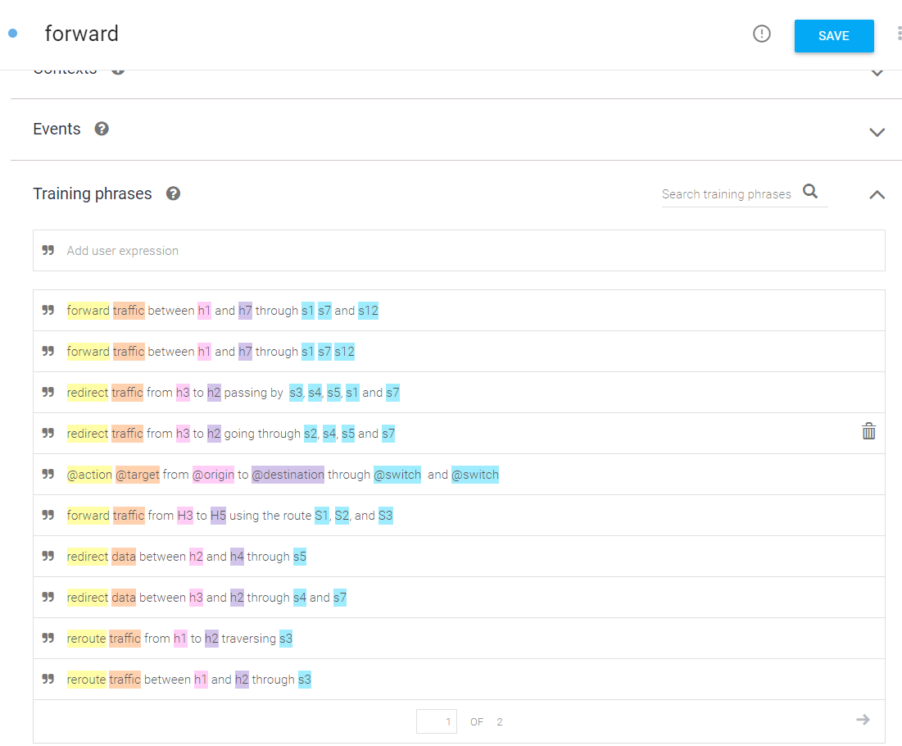
Dialogflow - Setup

Slide 11
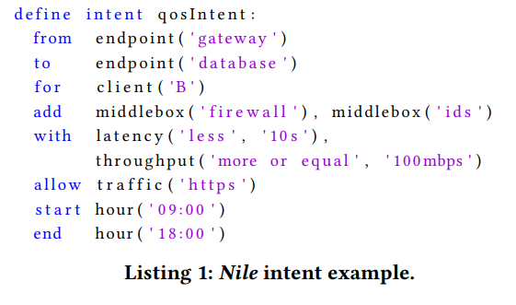
NILE - Example
Define intent forwardIntent:
do action(‘route’)
for target(‘traffic’)
from endpoint(‘h1’)
to endpoint(‘h7’)
following path (‘s1’, s8’, ‘s12’)
[1] Arthur Jacobs et. al - Refining Network Intents for Self-Driving Networks
Notes:
In computer science, Backus–Naur form or Backus normal form (BNF) is a notation technique for context-free grammars, often used to describe the syntax of languages used in computing, such as computer programming languages, document formats, instruction setsand communication protocols.

Slide 12

Deployment
{
"api_key": "test_key",
"routes":[
{
"key": "00:00:00:00:00:01/None00:00:00:00:00:07/None",
"route": [
"00:00:00:00:00:01/None",
"of:0000000000000001",
"of:0000000000000008",
"of:000000000000000c",
"00:00:00:00:00:07/None"
]
}
]
} ]
}
Define intent forwardIntent:
do action(‘route’)
for target(‘traffic’)
from endpoint(‘h1’)
to endpoint(‘h7’)
following path (‘s1’, s8’, ‘s12’)

Slide 13











Demo Scenario
List of hosts
retrieve
1-
Reroute traffic
push
2-
Service protection
push
3-
Reroute traffic
push
4-
maintenance
Alert
5-
Notes:
Predictive maintenance

Slide 14
Intent lifecycle – monitor and validation
Modern networks remain best-effort and dynamic.
Intents require continuous monitoring and validation.
Apply DevOps in network management (Mininet-CICD).
Exploit network automation to improve monitoring precision and efficiency (Uniprobe).
Notes:
Network misconfiguration and bugs are common.
Network failures can violate intent goals.
Network softwarisation affects QoS guarantees.

Slide 15


Devops with CICD
remote git
local git
push
deploy
commit
unit tests
testing environment
telemetry
production environment
Notes:
DevOps are key to allow faster service deployment times. Currently on the order of days. Devops+ automation can significantly reduce leads times.
Telementry is a major challenge:
Require:
flexbile: Allow develop to customize monitoring. Too much data can saturate your network.
Timely: Need to detect errors quickly.
Scalable: mVNF will lead to explosion of monitoring end-points.
How can we solve this?
What are we looking for with cicd:
Misconfiguration
Code bugs
Performance degradation
Enabling these capabilities in a networking environment is rather challenging.
> Monitoring can affect the performance of the application and the monitoring task (Should be tailored to the monitoring requirements).
> Monitoring is rather fixed. Logging information is fixed and not easily extendable, actively probing the system is not always possible due to the inavailability of in-network probing capaiblities.

Slide 16
Intent CICD – pre-deployment
Mininet-CICD
network
topology
Notes:
Mininet can offer scalability.
We need to also think the aspect of fidelity, especially in terms of middleboxes and

Slide 17

Intent CICD – pre-deployment
Intent
Deploy
Intent Manager
Mininet-CICD
network
topology

Slide 18
Intent CICD – pre-deployment
Test
IntentTester
Intent
Deploy
Intent Manager
Mininet-CICD
network
topology

Slide 19
Intent validation – run-time
Current telemetry techniques
  SNMP, NetFlow, nagios…
  Fixed and low-level.
  Manual and offline analysis.
Uniprobe – https://github.com/Uniprobe
  Intent-based network monitoring.
  Dynamic VNF probes (Unikernel VNF, Unimon API).

Slide 20
Intent deployment

Slide 21
Intent deployment - uniprobe

Slide 22

External Intent - Scenarios
Intent
Vertical
Service provider
Vertical
Service provider
Vertical
Service provider
End user
Vertical
Service provider
Intent
End user
Network
Network
Intent
Vertical
Service provider
Vertical
Service provider
Vertical
Service provider
Vertical
Service provider
End user
Intent
Intent
Intent
End user
Intent
Network
Network
Intent

Slide 23
External Intent –
QoE oriented vs. QoS oriented
Take video content delivery as an example…
Subjective QoE
Objective QoE
QoS
“I want for all my subscribers guaranteed 4K video quality without playback stalling, and start-up delay less than 1 second”
“I want for all my subscribers guaranteed 15Mbps data rate and less than 20ms network latency”
“I want all my subscribers to have mean opinion score (MOS) above 4.0”
Not appropriate – cannot
be objectively measured
Intent engine to translate into network configurations
Simply an SLA?

Slide 24
External Intent Framework Use Case
Content
subscribers
Scenario under consideration
  A three-stakeholder game – end user, content service provider (CSP), and the underlying network
  CSP “aggregates” the common intent from own subscribers and issue a general intent to the network
  E.g. “Provider guaranteed content performance at 4K quality to all my subscribers connected to your network, in both stationary and mobile conditions”
  Key features
    Offline expression of intent (SLA)
    “Encoded” intent in packet header (based on SRv6 framework)
    Automated service assurance during user handover (handovers between content cache servers, between base stations)
(Common) Intent:
Assured content
performances
Commercial content service provider
(Aggregated)
External Intent
Network
Internal Intent
(e.g. load balancing, failure protection…)

Slide 25
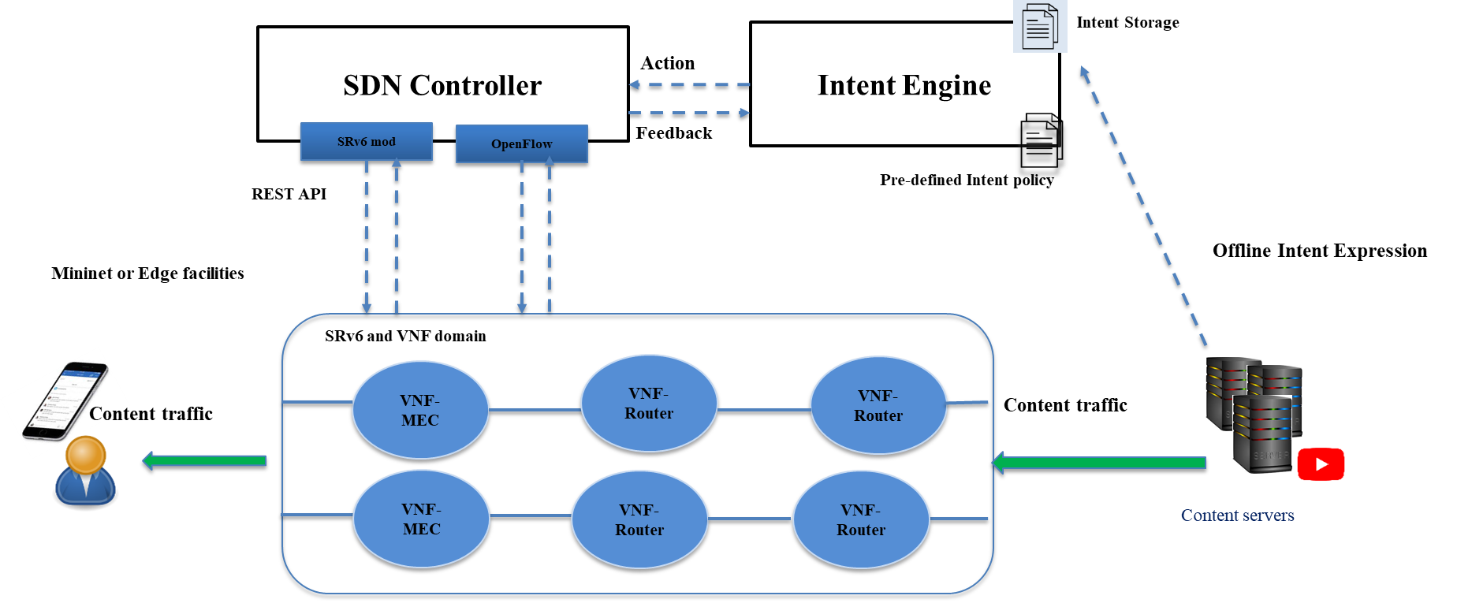
External Intent Framework Use Case

Slide 26
Implication to Network Slicing in 5G
Network Slices
  A tailored network capability catering for one or a group of services with common network support requirements, typically realised through the provisioning of network and computing/storage resources
  End-to-end 5G: RAN + Transport Network + Core Network
Upon receiving an external intent…
  Directly resolve the intent to an existing slice – suitable for end user intent?
  Create a new on-demand slice to fulfil the intent
    Possible for individual service providers, enterprise networks
    Complexity in binding RAN, transport and core capabilities to form an E2E slice that is able to fulfil the intent – Time complexity to create a slice on demand?

Slide 27
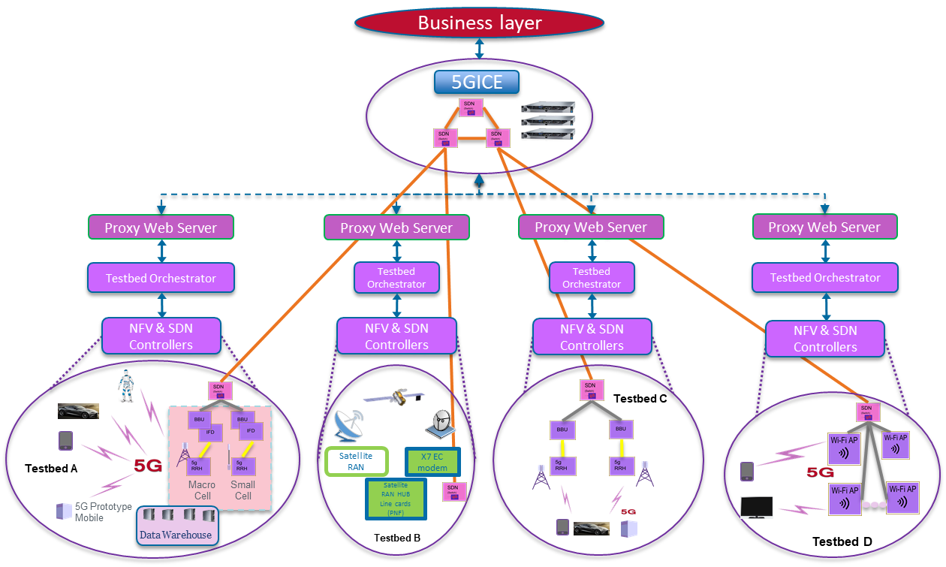
Planned Integrated Framework in 5G
Intent Expression
Interface
Key features
  Consists of heterogeneous types of networks
  Support pre-provisioned network slices (e.g. eMBB, URLLC and MMTC)
  Support on-demand creation of slices based on “simple (value-based) intent” or QoS requirements, within 1.5 minutes
  Simple “intent” interface at present – QoS requirements and service scope

Slide 28
Challenges on Intent-based Networking
How to maximize the degree of flexibility in intent expressions?
Expression
Unified or separate interfaces for different types of intent clients ( e.g. internal vs. external)?
How to translate (high-level, human-understandable) intent into (low-level, machine-understandable) configurations?
Translation
Maybe this is beyond a translation/compilation but could also involve optimization as well?
How to make sure if the assurance on the expressed intent can be fulfilled in dynamic/uncertain network environments?
Assurance
Should the dynamicity/uncertainty be “hidden” from the intent client?
How to detect and resolve potential conflicting intent expressed by different clients?
Conflict
Between different control agents, between peering autonomous systems (e.g. intent in BGP routing across domain boundaries)

Slide 29
Summary
Benefits of IBN in telecom industry
  Substantially reduces network configuration complexity
  Minimize misconfigurations made by human errors
  Allow clients to flexibly express business targets, requirements and constraints that can be automatically translated into configurations
NG-CDI technical work on IBN
  Management of intent lifecycle (capturing, translation, monitoring, validation)
  Flexible intent framework in multi-stakeholder environments
Technical challenges in IBN
  Expression, translation, verification, conflict detection and prevention

Slide 30
Intent validation – post-deployment
Intent telemetry (UNIPROBE)
VNF monitoring (UNIMON)
Traditional telemetry relies on available data:
  SNMP, NetFlow, nagios…
Frequently too generic, manual and offline.
Can we use intents to adapt network monitoring?
  Use in-network compute resources to deploy flexible monitoring.
  Use intent policy to adapt monitoring.
High-performance VNF platforms reduce performance visibility.
  Poll-based networking.
  Favor performance over monitoring.
Can we define a generic, low-overhead μVNF monitoring API?

Slide 31


Thank you
QUESTIONS?
Next Thought Leadership talk…
Intelligent Asset Management for Service Assurance & Infrastructure Management
Dr Ajith Parlikad.
Asset Management, University of Cambridge Institute for Manufacture.
​
8th December 2020, from 13.00 - 14.00.
Introduced by Arjun Parekh. Self-learning Networks, BT Applied Research
Notes:
Notes:

